Slide 1
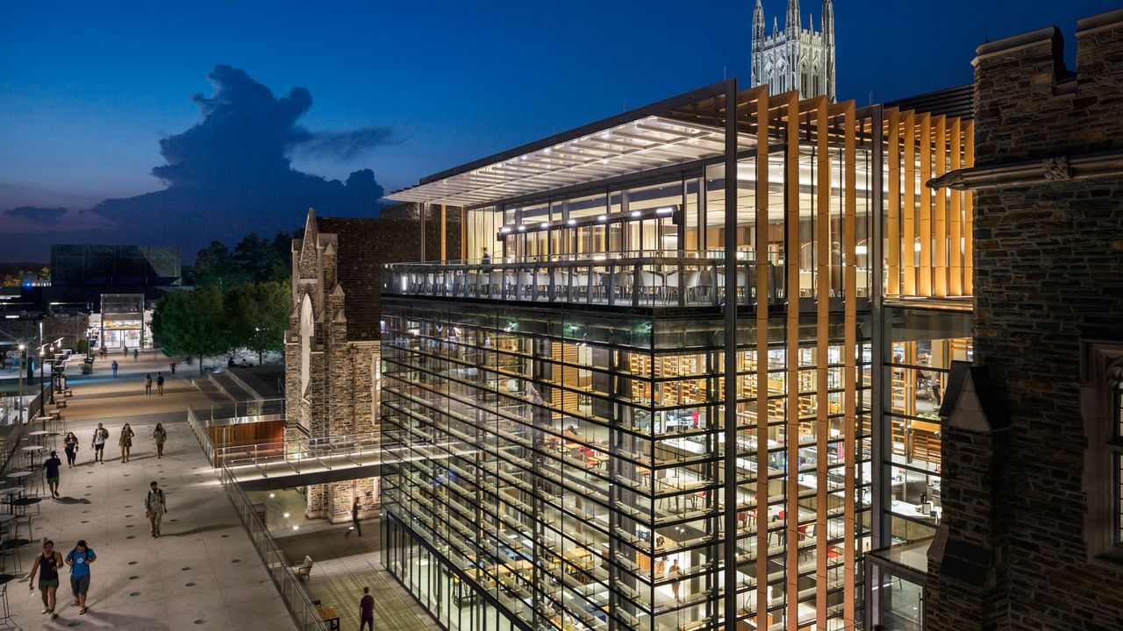
FINAL YEAR PROJECT DEFENSE
FlexiApply
A Smart Academic Application Platform
2026
Academic Technology Project

Slide 2
Introduction
Project Overview
Mission
To simplify academic admissions through technology, making the process accessible, efficient, and stress-free for all stakeholders.
FlexiApply is a comprehensive digital platform designed to streamline and modernize the academic application process for students and institutions.
Vision
To become the leading platform for academic admissions across institutions, setting new standards for digital transformation in education.
By unifying the application experience into a single, intuitive interface, FlexiApply eliminates the fragmentation and inefficiency of traditional admissions workflows.
5
3+
100%
Application Steps
Institutions
Responsive

Slide 3
The Challenge
Problem Statement
Key pain points in traditional academic application processes
Repetitive Data Entry
Poor Status Visibility
Students must fill out the same personal, academic, and contact information multiple times for different institutions, wasting valuable time and increasing frustration.
Applicants have limited or no visibility into their application status, creating anxiety and requiring frequent follow-up communications.
Fragmented Systems
High Error Rates
Lack of a centralized platform means students must navigate multiple websites, remember various credentials, and manage scattered application materials.
Manual processes lead to data entry errors , incomplete submissions, and missing documents, causing delays and potential rejection of applications.
Impact on Students
These challenges result in increased stress , wasted time , and missed opportunities —with some students abandoning applications entirely due to complexity and frustration.

Slide 4
The Solution
Proposed Solution
A unified platform transforming academic admissions
Centralized Platform
Key Advantages
A single web-based portal where students can discover, apply to, and manage applications across multiple institutions without switching between different systems.
Time Efficiency: Reduces application time by up to 70% through reusable profiles and intelligent forms
Error Reduction: Built-in validation prevents common mistakes before submission
Structured Workflow
Enhanced Organization: All applications and documents in one secure location
A guided, step-by-step application process that ensures all required information is collected systematically, reducing errors and omissions.
Improved Experience: Intuitive design reduces stress and increases completion rates
Real-Time Tracking
A personalized dashboard providing instant visibility into application status, submission history, and institutional responses.
Platform Status
Live & Deployed

Slide 5
Capabilities
Key Features
Comprehensive functionality designed for modern admissions
Multi-Step Application Form
Application Status Tracking
User Dashboard
Intelligent form divided into logical sections : Program Selection, Personal Details, Academic Information, Guardian Details, and Final Review.
Real-time dashboard showing application progress , submission status, institutional responses, and important deadlines.
Personalized hub displaying all applications , profile information, saved institutions, and application history in one view.
5 structured steps
Live updates
Centralized management
Form Validation
Responsive Design
Comprehensive client-side and server-side validation ensures data accuracy, required field completion, and format correctness before submission.
Fully responsive interface adapts seamlessly to desktops, tablets, and mobile devices, ensuring accessibility anywhere.

Slide 6
User Journey
How It Works
Simple 4-step process from registration to tracking
1
2
3
4
Create Account / Login
Complete Application Form
Review & Submit
Track Status
Students register with email or log in to access their personalized application portal and dashboard.
Fill out the multi-step form with program selection, personal details, academic history, and guardian information.
Review all entered information, make any necessary edits, and submit the application to the selected institution.
Monitor application progress in real-time through the dashboard, receiving updates on review status and decisions.
15-20
Average Completion Time
Most students complete their first application in 15-20 minutes , with subsequent applications taking even less time due to saved profile data.
Minutes

Slide 7
Technical Foundation
Technology Stack
Modern technologies powering the platform
React
Tailwind CSS
Architecture Highlights
Component-based frontend library enabling modular UI development, efficient state management, and seamless user interactions.
Utility-first CSS framework for rapid, responsive styling with consistent design patterns and mobile-first approach.
Component Modularity
Reusable React components ensure consistency, reduce code duplication, and accelerate development cycles.
Performance Optimized
Efficient rendering, code splitting, and lazy loading ensure fast page loads and smooth user experience.
RESTful API
Vercel
Standardized API architecture enabling seamless communication between frontend and backend services with JSON data exchange.
Cloud deployment platform providing reliable hosting, automatic scaling, CI/CD integration, and global CDN for fast performance.
Security First
Secure authentication, data validation, and HTTPS encryption protect user information throughout the application process.
Scalable Design
Architecture supports future growth, additional institutions, and new feature integration without major refactoring.

Slide 8
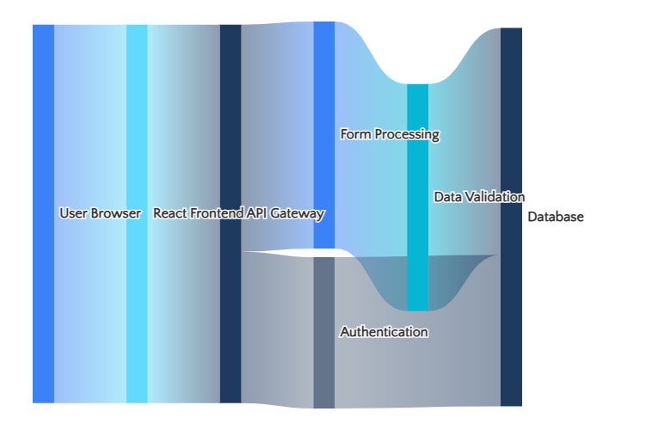
System Design
System Architecture
Technical design and data flow
Client-Server Interaction Flow
Client-Server Communication
Frontend React app communicates with backend services via RESTful API endpoints . HTTP requests handle data fetching, form submissions, and authentication with JSON response format.
Form Handling & Validation
Multi-layer validation ensures data integrity: client-side for immediate feedback, server-side for security, and database constraints for consistency.
Data Storage Concept
Structured data model includes User Profiles , Applications , Institutions , and Programs with relational connections for efficient querying.

Slide 9
Value Proposition
Benefits & Impact
Transforming the academic application experience
Time Savings
Error Reduction
Reduces application completion time by up to 70% through reusable profiles, auto-fill capabilities, and streamlined workflows.
Intelligent validation prevents common mistakes, ensuring complete and accurate submissions on the first attempt.
Traditional Process
With FlexiApply
Real-time field validation
60-90 min
15-20 min
Required field enforcement
Format verification
Improved Organization
Enhanced UX
Centralized dashboard provides complete visibility into all applications, deadlines, and institutional communications in one place.
Intuitive design and guided workflows reduce stress, increase completion rates, and create a positive application experience.
Overall Impact
70%
3x
100%
FlexiApply transforms a fragmented, stressful process into a unified, efficient experience —benefiting both applicants and institutions.
Time Saved
Faster
Tracking

Slide 10
Stakeholders
Target Users
Primary beneficiaries of the platform
Students
Institutions
Primary Applicants
Academic Organizations
Students seeking admission to universities, polytechnics, colleges, and other academic institutions who need an efficient, stress-free application process.
Universities, colleges, polytechnics, and schools seeking to modernize their admissions process and improve applicant experience.
High school graduates applying for undergraduate programs
Public and private universities
Current students seeking transfers or program changes
Technical and vocational institutions
Graduate students applying for master's or doctoral programs
Community colleges and specialized schools
International students navigating multiple application systems
Professional certification programs
Geographic Focus
3+
50+
∞
Currently serving Nigerian institutions with expansion potential across Africa and globally
Institutions
Programs
Scalability

Slide 11
Design Philosophy
UI/UX Design Highlights
User-centered design principles in action
Clean & Intuitive Interface
Interface Preview
Minimalist design eliminates clutter, uses whitespace effectively, and presents information clearly for effortless navigation.
flexiapply.vercel.app
FlexiApply
Step-by-Step Navigation
Progressive disclosure breaks complex forms into manageable sections with clear indicators of current position and remaining steps.
Find Your Path to Success
Discover and apply to top institutions
Search institutions...
Mobile Responsiveness
Fluid layouts adapt seamlessly to any screen size, ensuring full functionality on smartphones, tablets, and desktops.
University Name
University Name
University Name
Location
Location
Location
Accessibility Focus
WCAG-compliant design ensures usability for all, including proper contrast ratios, keyboard navigation, and screen reader support.
Design System
Primary
Secondary

Slide 12

Summary
Conclusion
Transforming academic admissions through technology
Problem Solved
Solution Delivered
FlexiApply successfully addresses the fragmentation, inefficiency, and stress of traditional academic application processes through a unified digital solution.
A modern, responsive, and user-friendly platform that streamlines applications, reduces errors, and provides real-time tracking for both students and institutions.
Key Takeaway
This project demonstrates how thoughtful technology application can transform complex, paper-based processes into efficient digital experiences—improving accessibility, reducing barriers, and creating value for all stakeholders in the academic ecosystem.

Slide 13
Roadmap
Future Improvements
Planned enhancements for continued growth
Institutional Integration
Notification System
Admin Dashboard
Direct integration with school databases and student information systems for seamless data exchange and automated verification.
Email and SMS notifications for application updates, deadline reminders, and institutional communications.
Comprehensive institution management interface for reviewing applications, managing programs, and communicating with applicants.
Q2 2026
Q2 2026
Q3 2026
Document Management
Analytics & Reporting
Multi-Language Support
Secure document upload and verification system for transcripts, certificates, and supporting materials.
Data analytics dashboard providing insights into application trends, demographics, and institutional performance.
Localization capabilities to support multiple languages, expanding accessibility across diverse populations.
Q3 2026
Q4 2026
Q4 2026
Development Roadmap
6
12
Continuous improvement driven by user feedback and institutional needs
Features
Months

Slide 14

CALL TO ACTION
Ready to Transform
Academic Admissions?
FlexiApply is live, tested, and ready for deployment. Join the movement to modernize academic applications and create better experiences for students and institutions.
For Institutions
For Students
For the Future
Streamline your admissions process and improve applicant satisfaction
Apply to multiple institutions with ease and track your progress
Scalable architecture ready for growth and new features
flexiapply.vercel.app
contact@flexiapply.com

